Slide 1

Mepco Schlenk Engineering College (Autonomous)
Predictive Analytics for Glucose Levels in Type 1 Diabetes Using Machine Learning
GUIDED BY,
Dr.S.Amutha
AP(Sl.Grade)
Muthukumarasamy S,21BCS171
Naren Karthikeyan M,21BCS172
Department of Computer Science and Engineering
1

Slide 2
Mepco Schlenk Engineering College (Autonomous)
Introduction
Accurate blood glucose (BG) prediction is crucial for managing type 1 diabetes (T1D) and preventing extreme glucose levels.
While traditional machine learning models effectively handle complex data, they lack interpretability.
Physiological white-box models simulate glucose-insulin dynamics and offer insights into BG fluctuations but are challenging to personalize and computationally intensive.
This research aims to develop a personalized BG prediction algorithm using a physiological white-box model and compare it with advanced black-box models to enhance T1D management tools and improve patient outcomes.
Department of Computer Science and Engineering
2

Slide 3
Mepco Schlenk Engineering College (Autonomous)
This research addresses the need for accurate blood glucose (BG) prediction models for type 1 diabetes (T1D).
Effective BG prediction is essential to prevent hyperglycemia and hypoglycemia, enhancing patient quality of life.
Current black-box models handle complex data well but lack interpretability, while physiological white-box models offer better insights but are hard to personalize and computationally intensive.
The goal is to find an optimal approach that combines the strengths of both model types for accurate, interpretable, and personalized BG predictions.
Problem Statement
Department of Computer Science and Engineering
3

Slide 4
Mepco Schlenk Engineering College (Autonomous)
Objectives
To develop a predictive model for glucose levels Prediction using machine learning techniques.
To design an algorithm for handling real-time data inputs and providing timely predictions to diabetes management.
To integrate data visualization tools to provide clear and comprehensive visual feedback on glucose level trends and patterns, aiding in better understanding and management for both patients and healthcare providers.
Department of Computer Science and Engineering
4

Slide 5
Mepco Schlenk Engineering College (Autonomous)
Expected Outcomes
Outcome 1:
Predictive Model Development: Achieve a highly accurate and robust machine learning model for forecasting blood glucose levels, validated with patient data.
Outcome 2:
Designed an algorithm that collect and preprocess real-time CGM data, insulin doses, and food intake for timely glucose predictions using a trained machine learning model.
Outcome 3:
Improved data sharing and visualization tools will facilitate better communication between patients and healthcare providers, leading to more effective and personalized care.
Department of Computer Science and Engineering
5

Slide 6
Mepco Schlenk Engineering College (Autonomous)
Literature Survey – Base Paper
Giacomo Cappon et al (2023) performed a study on,“Individualized Models for Glucose Prediction in Type 1 Diabetes: Comparing Black-Box Approaches to a Physiological White-Box One”, IEEE TRANSACTIONS ON BIOMEDICAL ENGINEERING, VOL. 70, NO. 11, NOVEMBER 2023.
Methodologies Adopted:
Black-box Approaches: Utilize machine learning techniques to model complex relationships without explicit physiological knowledge. They excel in capturing nonlinear patterns in data.
White-box Model: A structured physiological model that reflects biological processes, providing insights into glucose regulation mechanisms. It requires extensive parameter tuning, which can be complex.
Adaptive Strategies: The rARX model updates parameters based on new CGM data, enhancing prediction accuracy. This adaptability is crucial for real-time diabetes management.
Giacomo Cappon , Francesco Prendin , Andrea Facchinetti , Giovanni Sparacino and Simone Del Favero, “Individualized Models for Glucose Prediction in Type 1 Diabetes: Comparing Black-Box Approaches to a Physiological White-Box One”, IEEE TRANSACTIONS ON BIOMEDICAL ENGINEERING, VOL. 70, NO. 11, NOVEMBER 2023
Department of Computer Science and Engineering
6

Slide 7
Mepco Schlenk Engineering College (Autonomous)
Literature Survey - Base Paper Contd..
Merits:
High Prediction Accuracy: Black-box models often outperform traditional methods, effectively learning from large datasets
Physiological Insight: White-box models offer valuable insights into glucose regulation, understanding patient-specific responses
Adaptability: Adaptive strategies allow real-time updates, making them responsive to changes in a patient's condition .
Demerits:
Lack of Interpretability: Black-box models can be difficult to interpret, hindering clinician trust in predictions
Complexity of White-box Models: These models can be resource-intensive and require extensive tuning, which may be time-consuming
Data Dependency: Adaptive strategies depend on the quality of CGM data; poor data can lead to inaccurate predictions.
Giacomo Cappon , Francesco Prendin , Andrea Facchinetti , Giovanni Sparacino and Simone Del Favero, “Individualized Models for Glucose Prediction in Type 1 Diabetes: Comparing Black-Box Approaches to a Physiological White-Box One”, IEEE TRANSACTIONS ON BIOMEDICAL ENGINEERING, VOL. 70, NO. 11, NOVEMBER 2023
Department of Computer Science and Engineering
7

Slide 8
Mepco Schlenk Engineering College (Autonomous)
Literature Survey - 1
Cindy Marling1 & Razvan Bunescu1 (2020) performed a study on “The OhioT1DM Dataset for Blood Glucose Level Prediction Update 2020”
Methodologies Used:
Data Collection: Continuous glucose monitoring and insulin data from 12 individuals with type 1 diabetes over 8 weeks.
Physiological Monitoring: Participants wore fitness bands for heart rate and activity data.
Self-Reported Data: Life events affecting glucose levels were recorded via a smartphone app.
Merits:
Comprehensive:
1)Combines various data types for better analysis.
Cindy Marling1, Razvan Bunescu1, “The OhioT1DM Dataset for Blood Glucose Level Prediction Update 2020”, EUR Workshop Proc. 2020 September ; 2675: 71–74
Department of Computer Science and Engineering
8

Slide 9
Mepco Schlenk Engineering College (Autonomous)
Literature Survey – 1 Contd..
Longitudinal:
1)8-week duration allows for trend observation
Demerits:
Small Sample Size:
1)Limits generalizability.
Data Gaps:
2)Missing overnight data from some participants.
Cindy Marling1, Razvan Bunescu1, “The OhioT1DM Dataset for Blood Glucose Level Prediction Update 2020”, EUR Workshop Proc. 2020 September ; 2675: 71–74
Department of Computer Science and Engineering
9

Slide 10
Mepco Schlenk Engineering College (Autonomous)
Literature Survey - 2
Mario Munoz-Organero (2021) performed a study on “Deep Physiological Model for Blood Glucose Prediction in T1DM Patients”
Methodologies Adopted:
Developed a deep learning model that incorporates physiological data to predict blood glucose levels in Type 1 diabetes (T1DM) patients.
Utilized deep neural networks to model complex physiological interactions affecting glucose levels.
Merits:
Leverages deep learning to capture complex physiological interactions for accurate glucose prediction.
Mario Munoz-Organero, “Deep physiological model for blood glucose prediction in T1DM patients”, Sensors 2020, 20,3896.
Department of Computer Science and Engineering
10

Slide 11
Mepco Schlenk Engineering College (Autonomous)
Literature Survey – 2 Contd..
Provides insights into physiological factors affecting blood glucose levels.
Improves prediction accuracy for T1DM patients through advanced modeling techniques.
Demerits:
Requires extensive and high-quality physiological data for effective training.
Deep learning models can be computationally intensive and complex.
May face challenges in generalizing across diverse patient populations.
Mario Munoz-Organero, “Deep physiological model for blood glucose prediction in T1DM patients”, Sensors 2020, 20,3896.
Department of Computer Science and Engineering
11

Slide 12
Mepco Schlenk Engineering College (Autonomous)
Literature Survey - 3
Ganjar Alfian et al. (2021) performed a study on “Blood glucose prediction model for type 1 diabetes based on artificial neural network with time-domain features”
Methodologies Adopted:
Data Collection: Real-world blood glucose data from type 1 diabetes patients.
Feature Extraction: Time-domain features such as glucose trends and patterns over time were extracted.
Model Development: Artificial Neural Network (ANN) was used to develop the prediction model.
Evaluation: Performance metrics included Mean Absolute Error (MAE) and Root Mean Squared Error (RMSE).
Ganjar Alfian, Muhammad Syafrudin, Muhammad Anshari, Filip Benes, Fransiskus Tatas Dwi Atmaji, Imam Fahrurrozi, Ahmad Fathan Hidayatullah, Jongtae Rhee, “Blood glucose prediction model for type 1 diabetes based on artificial neural network with time-domain features”, Journal of Biomedical Informatics, 109 (2021) 103538.
Department of Computer Science and Engineering
12

Slide 13
Mepco Schlenk Engineering College (Autonomous)
Literature Survey- 3 Contd..
Merits:
Utilizes time-domain features for improved prediction accuracy.
Effective in capturing glucose trends and patterns over time.
ANN model demonstrates robust performance in predictions.
Demerits:
Requires continuous and high-quality data for training.
ANN models can be complex and resource-intensive.
Model may not account for all variability in individual glucose responses.
Ganjar Alfian, Muhammad Syafrudin, Muhammad Anshari, Filip Benes, Fransiskus Tatas Dwi Atmaji, Imam Fahrurrozi, Ahmad Fathan Hidayatullah, Jongtae Rhee, “Blood glucose prediction model for type 1 diabetes based on artificial neural network with time-domain features”, Journal of Biomedical Informatics, 109 (2021) 103538.
Department of Computer Science and Engineering
13

Slide 14
Mepco Schlenk Engineering College (Autonomous)
Literature Survey - 4
Jobeda Jamal Khanam & Simon Y. Foo (2021) conducted a study on "A comparison of machine learning algorithms for diabetes prediction“
Methodologies Adopted:
Compared various machine learning algorithms for predicting diabetes.
Evaluated the performance of each algorithm using standard metrics like accuracy, precision, and recall.
Merits:
Provides a comprehensive comparison of different machine learning algorithms for diabetes prediction.
Helps identify the most effective algorithm based on performance metrics.
Offers insights into the strengths and weaknesses of various predictive models.
Jobeda Jamal Khanam, Simon Y. Foo, “A comparison of machine learning algorithms for diabetes prediction”, ICT Express 7 (2021) 432-439.
Department of Computer Science and Engineering
14

Slide 15
Mepco Schlenk Engineering College (Autonomous)
Literature Survey – 4 Contd..
Demerits:
Performance may vary depending on the quality and characteristics of the dataset used.
The study may not account for algorithm-specific tuning and optimization processes.
Requires substantial computational resources for evaluating multiple algorithms.
Jobeda Jamal Khanam, Simon Y. Foo, “A comparison of machine learning algorithms for diabetes prediction”, ICT Express 7 (2021) 432-439.
Department of Computer Science and Engineering
15

Slide 16
Mepco Schlenk Engineering College (Autonomous)
Literature Survey - 5
Wonju Seoa et al. (2021) performed a study on “A personalized blood glucose level prediction model with a fine-tuning strategy: A proof-of-concept study”
Methodologies Adopted:
Data Collection: Real-world CGM data, contextual info (meal intake, physical activity, insulin dosage).
Model Development: Initial training on a generic dataset using regression models and neural networks.
Fine-Tuning Strategy: Transfer learning for personalization, custom loss function for glucose response variability.
Evaluation: Metrics (MAE, RMSE), comparative analysis with baseline models.
Wonju Seoa, Sung-Woon Park, Namho Kima, Sang-Man Jinc, Sung-Min Parka, “A personalized blood glucose level prediction model with a fine-tuning strategy: A proof-of-concept study”, Computer Methods and Programs in Biomedicine, 211 (2021) 106424.
Department of Computer Science and Engineering
16

Slide 17
Mepco Schlenk Engineering College (Autonomous)
Literature Survey - 5 Contd..
Merits:
Improved prediction accuracy through personalized fine-tuning.
Tailored to individual patient data.
Incorporates meal intake, physical activity, and insulin dosage for more relevant predictions.
Demerits:
Needs extensive and continuous data collection from patients.
Advanced machine learning techniques increase model complexity.
May not perform well without sufficient patient-specific data
Wonju Seoa, Sung-Woon Park, Namho Kima, Sang-Man Jinc, Sung-Min Parka, “A personalized blood glucose level prediction model with a fine-tuning strategy: A proof-of-concept study”, Computer Methods and Programs in Biomedicine, 211 (2021) 106424.
Department of Computer Science and Engineering
17

Slide 18
Mepco Schlenk Engineering College (Autonomous)
Literature Survey - 6
Hatice Vildan Dudukcu et al. (2021) performed a study on "Blood glucose prediction with deep neural networks using weighted decision level fusion“
Methodologies Adopted:
Utilized deep neural networks combined with weighted decision level fusion to predict blood glucose levels.
Integrated multiple prediction models and applied fusion techniques to improve accuracy and robustness.
Merits:
Enhances prediction accuracy by combining multiple models through weighted decision level fusion.
Hatice Vildan Dudukcu, Murat Taskiran, Tulay Yildirim, “Blood glucose prediction with deep neural networks using weighted decision level fusion”, biocybernetics and biomedical engineering 41 (2021) 1208– 1223
Department of Computer Science and Engineering
18

Slide 19
Mepco Schlenk Engineering College (Autonomous)
Literature Survey – 6 Contd..
Deep neural networks capture complex patterns in glucose data effectively.
Improves robustness and reliability of predictions.
Demerits:
Requires significant computational resources for training and fusion processes.
Complexity of the model may make it difficult to interpret and fine-tune.
Performance heavily depends on the quality of input data and fusion weights.
Hatice Vildan Dudukcu, Murat Taskiran, Tulay Yildirim, “Blood glucose prediction with deep neural networks using weighted decision level fusion”, biocybernetics and biomedical engineering 41 (2021) 1208– 1223
Department of Computer Science and Engineering
19

Slide 20
Mepco Schlenk Engineering College (Autonomous)
Literature Survey - 7
Shahid Mohammad Ganie & Majid Bashir Malik (2021) performed a study on “An ensemble Machine Learning approach for predicting Type-I diabetes mellitus based on lifestyle indicators”
Methodologies Adopted:
Applied an ensemble machine learning approach to predict Type-I diabetes using lifestyle indicators (e.g., diet, physical activity).
Combined multiple machine learning models to improve prediction accuracy and robustness.
Merits:
Utilizes an ensemble approach to enhance prediction accuracy and reduce overfitting.
Shahid Mohammad Ganie, Majid Bashir Malik, “An ensemble machine learning approach for predicting Type-I diabetes mellitus based on lifestyle indicators”, Health Care Analysis 2 (2022) 100092.
Department of Computer Science and Engineering
20

Slide 21
Mepco Schlenk Engineering College (Autonomous)
Literature Survey – 7 Contd..
Incorporates lifestyle indicators, which are crucial for predicting Type-I diabetes.
Provides a more robust and reliable prediction model.
Demerits:
Requires integration and tuning of multiple models, which can be complex and resource-intensive.
Performance may vary based on the quality and relevance of lifestyle data.
May require extensive preprocessing and feature selection.
Shahid Mohammad Ganie, Majid Bashir Malik, “An ensemble machine learning approach for predicting Type-I diabetes mellitus based on lifestyle indicators”, Health Care Analysis 2 (2022) 100092.
Department of Computer Science and Engineering
21

Slide 22
Mepco Schlenk Engineering College (Autonomous)
Literature Survey - 8
Guanci Yang et al. (2021) performed a study on "Short-term prediction method of blood glucose based on temporal multi-head attention mechanism for diabetic patients“
Methodologies Adopted:
Implemented a temporal multi-head attention mechanism to predict short-term blood glucose levels.
Utilized historical glucose data and attention mechanisms to enhance prediction accuracy.
Merits:
Leverages advanced attention mechanisms for improved prediction accuracy.
Guanci Yang, Saisai Liu, Yang Li, Ling He, “Short-term prediction method of blood glucose based on temporal multi-head attention mechanism for diabetic patients”, Biomedical Signal Processing and Control 82 (2023) 104552.
Department of Computer Science and Engineering
22

Slide 23
Mepco Schlenk Engineering College (Autonomous)
Literature Survey – 8 Contd..
Focuses on short-term glucose level predictions, which is crucial for timely diabetes management.
Captures temporal dependencies in glucose data effectively.
Demerits:
Requires extensive historical data to train the model effectively.
The complexity of the attention mechanism may increase computational demands.
Performance may vary with different types of glucose monitoring devices.
Guanci Yang, Saisai Liu, Yang Li, Ling He, “Short-term prediction method of blood glucose based on temporal multi-head attention mechanism for diabetic patients”, Biomedical Signal Processing and Control 82 (2023) 104552.
Department of Computer Science and Engineering
23

Slide 24
Mepco Schlenk Engineering College (Autonomous)
Literature Survey - 9
Gangani Dharmarathne et al. (2021) performed a study on “A novel machine learning approach for diagnosing diabetes with a self-explainable interface”
Methodologies Adopted:
Developed a machine learning model for diabetes diagnosis with a focus on interpretability.
Implemented a self-explainable interface to provide transparent and understandable predictions.
Merits:
Enhances transparency and interpretability of the machine learning model.
Gangani Dharmarathne, Thilini N. Jayasinghe, Madhusha Bogahawaththa, D.P.P. Meddage, Upaka Rathnayake, “A novel machine learning approach for diagnosing diabetes with a self-explainable interface”, Healthcare Analysis, (2024) 100301.
Department of Computer Science and Engineering
24

Slide 25
Mepco Schlenk Engineering College (Autonomous)
Literature Survey - 9 Contd..
Provides clear explanations of diagnosis decisions, aiding user trust and understanding.
Potentially improves diagnostic accuracy with advanced machine learning techniques.
Demerits:
Model complexity might impact the ease of explanation and interface usability.
Requires substantial computational resources for developing and maintaining the self-explainable interface.
May be limited by the quality and representativeness of the training data.
Gangani Dharmarathne, Thilini N. Jayasinghe, Madhusha Bogahawaththa, D.P.P. Meddage, Upaka Rathnayake, “A novel machine learning approach for diagnosing diabetes with a self-explainable interface”, Healthcare Analysis, (2024) 100301
Department of Computer Science and Engineering
25

Slide 26
Mepco Schlenk Engineering College (Autonomous)
Literature Survey - 10
Sean Pikulin et al. (2021) performed a study on “Enhanced blood glucose levels prediction with a smartwatch”
Methodologies Adopted:
Used smartwatch sensors to collect physiological data.
Developed a predictive model to estimate blood glucose levels based on smartwatch data.
Merits:
Integrates wearable technology for continuous glucose monitoring.
Provides real-time glucose predictions based on physiological data.
Non-invasive and convenient for users.
Sean Pikulin, Irad Yehezkel, Robert Moskovitch, “Enhanced blood glucose levels prediction with a smartwatch”, PLoS ONE 19(7) (2024)
Department of Computer Science and Engineering
26

Slide 27
Mepco Schlenk Engineering College (Autonomous)
Literature Survey – 10 Contd..
Demerits:
Accuracy may depend on the quality and type of data collected by the smartwatch.
Limited by the smartwatch’s sensor capabilities and data granularity.
Potential issues with data privacy and security.
Sean Pikulin, Irad Yehezkel, Robert Moskovitch, “Enhanced blood glucose levels prediction with a smartwatch”, PLoS ONE 19(7) (2024)
Department of Computer Science and Engineering
27

Slide 28
Mepco Schlenk Engineering College (Autonomous)
Literature Survey
Consolidation of the literatures:
S.No. | Author(s) & Year | Methodology used | Limitations
1 | Cindy Marling, Razvan Bunescu (2020) | OhioT1DM dataset for blood glucose level prediction | Limited by the scope and specifics of the dataset, which may not represent broader population diversity.
2 | Mario Munoz-Organero (2020) | Deep physiological model has been used. | The model may not generalize well to all patients due to individual physiological differences.
Department of Computer Science and Engineering
28

Slide 29
Mepco Schlenk Engineering College (Autonomous)
Literature Survey
Consolidation of the literatures:
S.No. | Author(s) & Year | Methodology used | Limitations
3 | Ganjar Alfian, Muhammad Syafrudin, Muhammad Anshari (2020) | Artificial neural network with time-domain features | Limited by the dataset size and diversity, which may affect the model’s robustness and generalizability.
4 | Jobeda Jamal Khanam, Simon Y. Foo (2021) | Comparison of machine learning algorithms | Performance may vary depending on the dataset used; does not identify the best algorithm universally applicable.
Department of Computer Science and Engineering
29

Slide 30
Mepco Schlenk Engineering College (Autonomous)
Literature Survey
Consolidation of the literatures:
S.No. | Author(s) & Year | Methodology used | Limitations
5 | Wonju Seo, Sung-Woon Park, Namho Kim, Sang-Man Jin, Sung-Min Park (2021) | Personalized blood glucose level prediction model with a fine-tuning strategy | Fine-tuning strategy may be computationally intensive and time-consuming.
6 | Hatice Vildan Dudukcu, Murat Taskiran, Tulay Yildirim (2021) | Deep neural networks using weighted decision level fusion | High computational requirements and potential overfitting due to the complexity of the model.
Department of Computer Science and Engineering
30

Slide 31
Mepco Schlenk Engineering College (Autonomous)
Literature Survey
Consolidation of the literatures:
S.No. | Author(s) & Year | Methodology used | Limitations
7 | Shahid Mohammad Ganie & Majid Bashir Malik (2022) | Ensemble machine learning approach based on lifestyle indicators | May not account for all lifestyle variables affecting diabetes, leading to incomplete predictions.
8 | Guanci Yang, Saisai Liu, Yang Li, Ling He (2023) | Short-term prediction using temporal multi-head attention mechanism | May require significant computational resources and may not be suitable for long-term predictions.
Department of Computer Science and Engineering
31

Slide 32
Mepco Schlenk Engineering College (Autonomous)
Literature Survey
Consolidation of the literatures:
S.No. | Author(s) & Year | Methodology used | Limitations
9 | Gangani Dharmarathne, Thilini N. Jayasinghe, Madhusha Bogahawaththa, D.P.P. Meddage, Upaka Rathnayake (2024) | Machine learning approach with a self-explainable interface | Self-explainable interface might complicate the model, potentially reducing prediction accuracy.
10 | Sean Pikulin, Irad Yehezkel, Robert Moskovitch (2024) | Enhanced blood glucose levels prediction with a smartwatch | Reliant on smartwatch sensor accuracy and consistency, which can vary and impact the model’s predictions.
Department of Computer Science and Engineering
32

Slide 33
Mepco Schlenk Engineering College (Autonomous)
System Design of the Existing Approach
Fig 1.1:Existing Approach
Department of Computer Science and Engineering
33

Slide 34
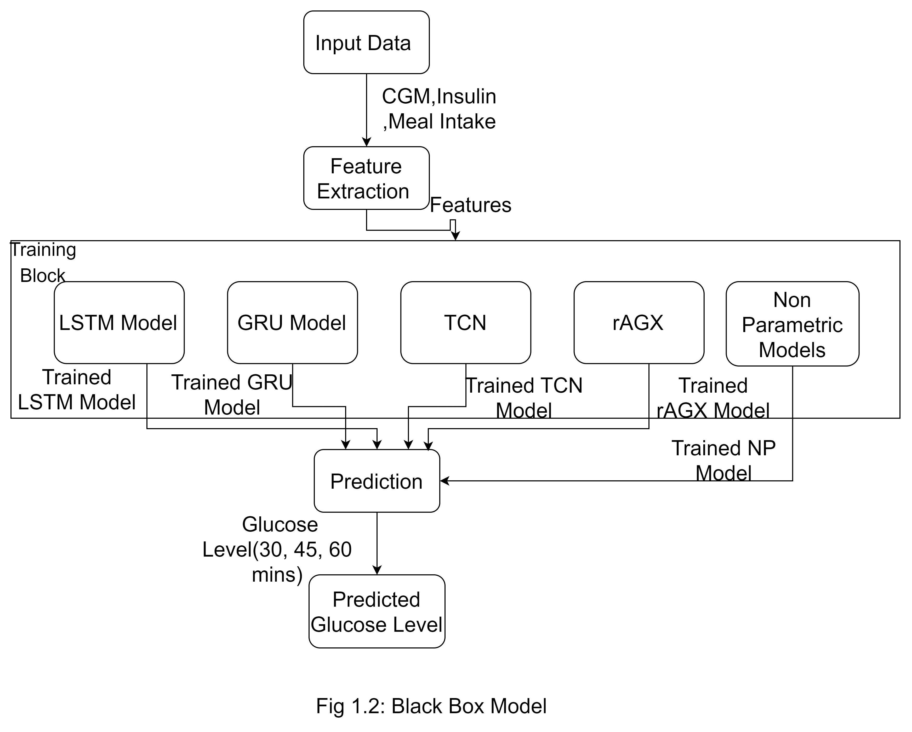
Mepco Schlenk Engineering College (Autonomous)
Black Box Implementation
Department of Computer Science and Engineering
34

Slide 35
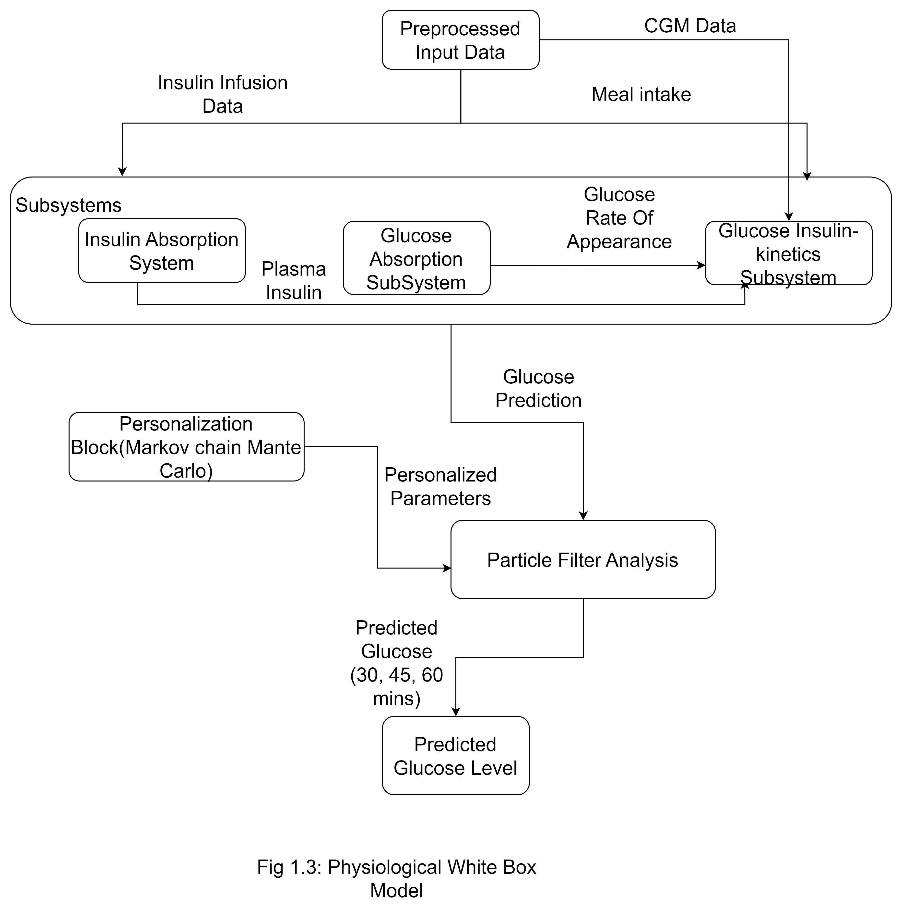
Mepco Schlenk Engineering College (Autonomous)
Physiological White Box Model
Department of Computer Science and Engineering
35

Slide 36
Mepco Schlenk Engineering College (Autonomous)
System Design of the Proposed Layered Approach
Fig 1.4: Proposed Layer Approach
Department of Computer Science and Engineering
36

Slide 37
Mepco Schlenk Engineering College (Autonomous)
Problem Definition and Description of Model
The primary challenge addressed in this research is the accurate prediction of blood glucose (BG) levels in individuals with Type 1 Diabetes (T1D).
Effective glucose control is vital to prevent hypoglycemia, hyperglycemia, and severe health complications.
Traditional models struggle to adapt to glucose metabolism's variability, influenced by meals, insulin, and individual responses.
Compares a physiologically-based white-box model with black-box machine learning models to improve prediction accuracy and adaptability..
Department of Computer Science and Engineering
37

Slide 38
Mepco Schlenk Engineering College (Autonomous)
Problem Definition and Description of Model
1. Data Input Module
Description: This module is essential for gathering and preprocessing the data necessary for glucose prediction. It includes:
Continuous Glucose Monitoring (CGM) Data: Real-time BG levels collected from CGM devices.
Nutritional Information: Data on carbohydrate intake, including meal timing and composition.
Insulin Administration Records: Details about the type and dosage of insulin administered.
Techniques: Data is normalized and formatted as time-series to ensure compatibility with prediction algorithms, enhancing input quality and reliability.
Department of Computer Science and Engineering
38

Slide 39
Mepco Schlenk Engineering College (Autonomous)
Problem Definition and Description of Model
White-Box Model Module
Description:
This module implements a nonlinear physiological model simulating glucose-insulin dynamics as a benchmark for comparison against black-box models.
Techniques:
The model uses physiological equations to describe glucose-insulin interactions, incorporating insulin absorption and glucose kinetics for interpretable, biologically-based predictions.
Department of Computer Science and Engineering
39

Slide 40
Mepco Schlenk Engineering College (Autonomous)
Problem Definition and Description of Model
Algorithm:
Bayesian estimation: Markov Chain Monte Carlo (MCMC) is used to estimate the individual parameters(Which uses Single Component Metropolis- Hastings).
Particle Filter (PF): A state-estimation method that handles the non-linearity and allows real-time glucose prediction .
Insulin Absorption Subsystem:
Description: Tracks subcutaneous insulin absorption, accounting for injected insulin entering the bloodstream..
Techniques: Utilizes compartments for insulin states (non-monomeric and monomeric) and equations for diffusion and absorption to predict plasma insulin levels.
Department of Computer Science and Engineering
40

Slide 41
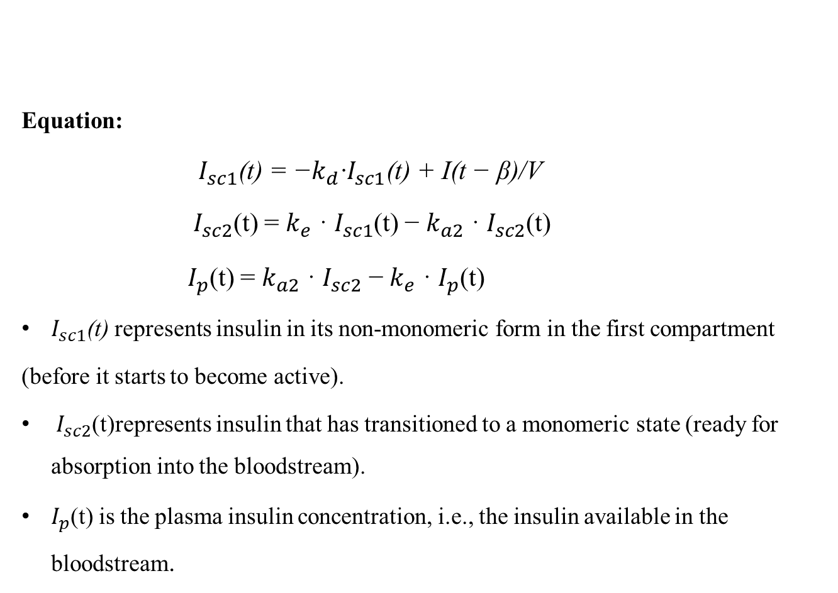
Mepco Schlenk Engineering College (Autonomous)
Problem Definition and Description of Model
Equation:
$I_{sc1}\text{(}\text{t}\text{) = −}k_{d}\text{·}I_{sc1}\text{(}\text{t}\text{) + }\text{I}\text{(}\text{t}\text{ − }\text{β}\text{)/}\text{V}$
${ I}_{sc2}$(t) = $k_{e}$ · $I_{sc1}$(t) − $k_{a2}$ · $I_{sc2}$(t)
${ I}_{p}$(t) = $k_{a2}$ · $I_{sc2}$ − $k_{e}$ · $I_{p}$(t)
$I_{sc1}\text{(}\text{t}\text{) }$represents insulin in its non-monomeric form in the first compartment
(before it starts to become active).
${ I}_{sc2}$(t)represents insulin that has transitioned to a monomeric state (ready for absorption into the bloodstream).
$I_{p}$(t) is the plasma insulin concentration, i.e., the insulin available in the bloodstream.
Department of Computer Science and Engineering
41

Slide 42
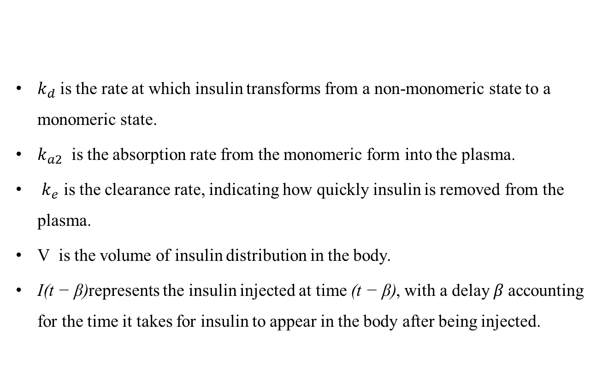
Mepco Schlenk Engineering College (Autonomous)
Problem Definition and Description of Model
$k_{d}$is the rate at which insulin transforms from a non-monomeric state to a monomeric state.
$k_{a2}$ ​ is the absorption rate from the monomeric form into the plasma.
$k_{e}$ is the clearance rate, indicating how quickly insulin is removed from the plasma.
V is the volume of insulin distribution in the body.
$\text{I}\text{(}\text{t}\text{ − }\text{β}\text{)}$represents the insulin injected at time $\text{(}\text{t}\text{ − }\text{β}\text{)}$, with a delay 𝛽 accounting for the time it takes for insulin to appear in the body after being injected.
Department of Computer Science and Engineering
42

Slide 43
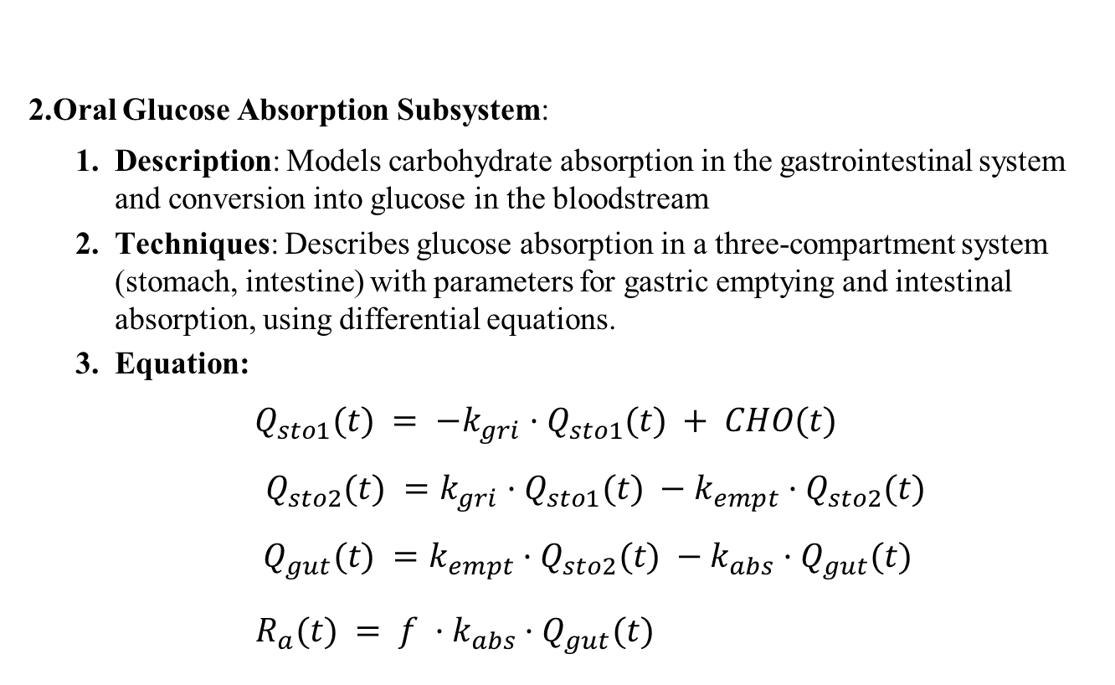
Mepco Schlenk Engineering College (Autonomous)
Problem Definition and Description of Model
2.Oral Glucose Absorption Subsystem:
Description: Models carbohydrate absorption in the gastrointestinal system and conversion into glucose in the bloodstream
Techniques: Describes glucose absorption in a three-compartment system (stomach, intestine) with parameters for gastric emptying and intestinal absorption, using differential equations.
Equation:
$$Q_{sto1}(t) = −k_{gri}·Q_{sto1}(t) + CHO(t)$$
$${ Q}_{sto2}(t) =k_{gri}·Q_{sto1}(t) −k_{empt}·Q_{sto2}(t)$$
$${ Q}_{gut}(t) =k_{empt}·Q_{sto2}(t) −k_{abs}·Q_{gut}(t)$$
$R_{a}(t) = f ·k_{abs}·Q_{gut}(t)$
Department of Computer Science and Engineering
43

Slide 44
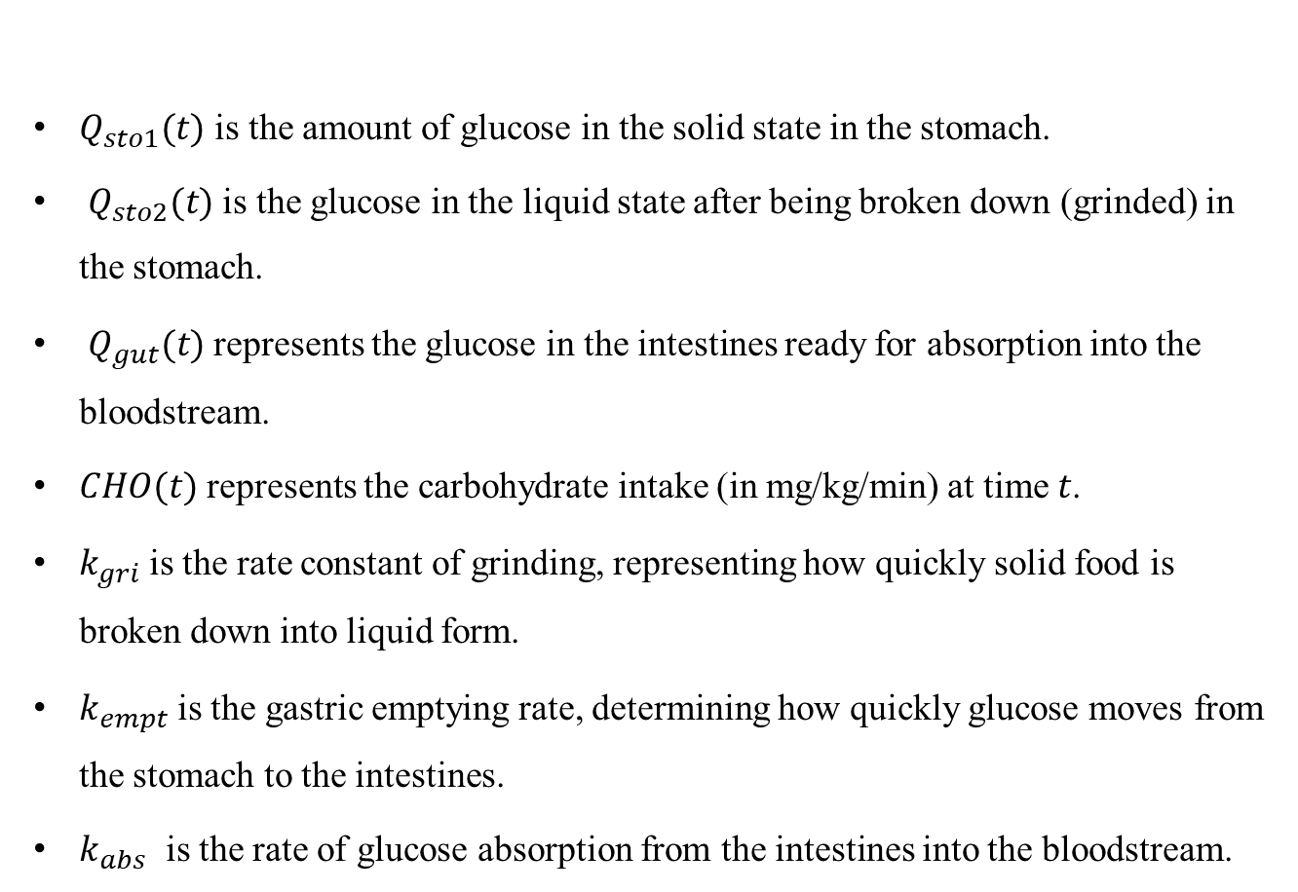
Mepco Schlenk Engineering College (Autonomous)
Problem Definition and Description of Model
$Q_{sto1}(t)$ is the amount of glucose in the solid state in the stomach.
$Q_{sto2}(t)$is the glucose in the liquid state after being broken down (grinded) in the stomach.
$Q_{gut}(t)$represents the glucose in the intestines ready for absorption into the bloodstream.
$CHO(t)$represents the carbohydrate intake (in mg/kg/min) at time 𝑡.
$k_{gri}$is the rate constant of grinding, representing how quickly solid food is broken down into liquid form.
​$k_{empt}$is the gastric emptying rate, determining how quickly glucose moves from the stomach to the intestines.
$k_{abs}$​ is the rate of glucose absorption from the intestines into the bloodstream.
Department of Computer Science and Engineering
44

Slide 45
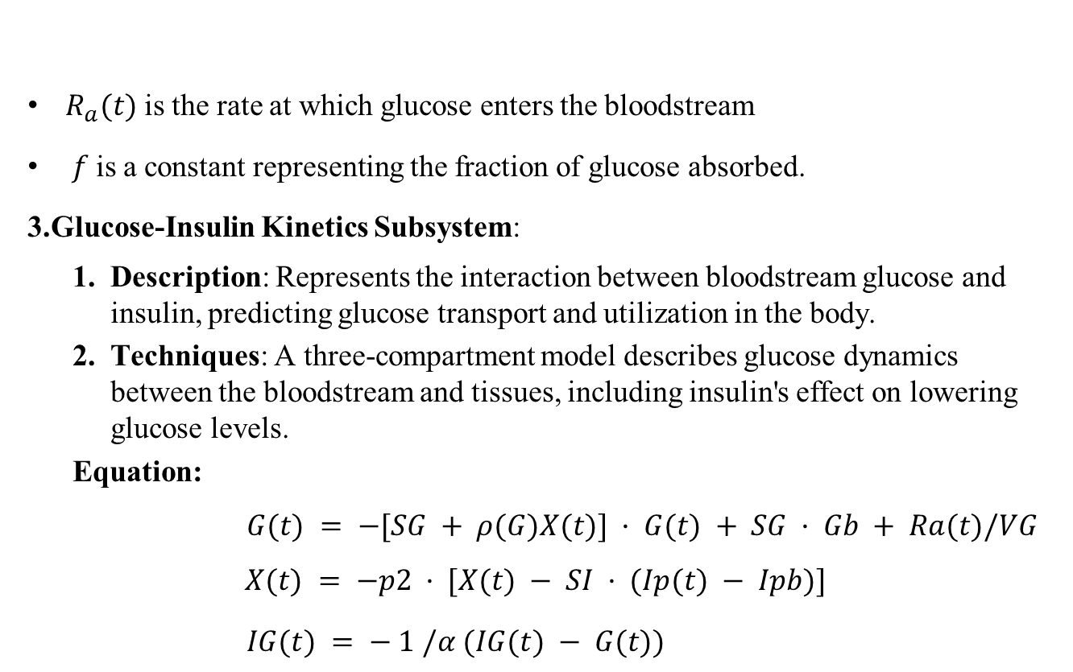
Mepco Schlenk Engineering College (Autonomous)
Problem Definition and Description of Model
$R_{a}(t)$is the rate at which glucose enters the bloodstream
$f$is a constant representing the fraction of glucose absorbed.
3.Glucose-Insulin Kinetics Subsystem:
Description: Represents the interaction between bloodstream glucose and insulin, predicting glucose transport and utilization in the body.
Techniques: A three-compartment model describes glucose dynamics between the bloodstream and tissues, including insulin's effect on lowering glucose levels.
Equation:
$G(t) = −[SG + ρ(G)X(t)] · G(t) + SG · Gb + Ra(t)/VG$
$$X(t) = −p2 · [X(t) − SI · (Ip(t) − Ipb)]$$
$IG(t) = − 1 /α (IG(t) − G(t))$
Department of Computer Science and Engineering
45

Slide 46
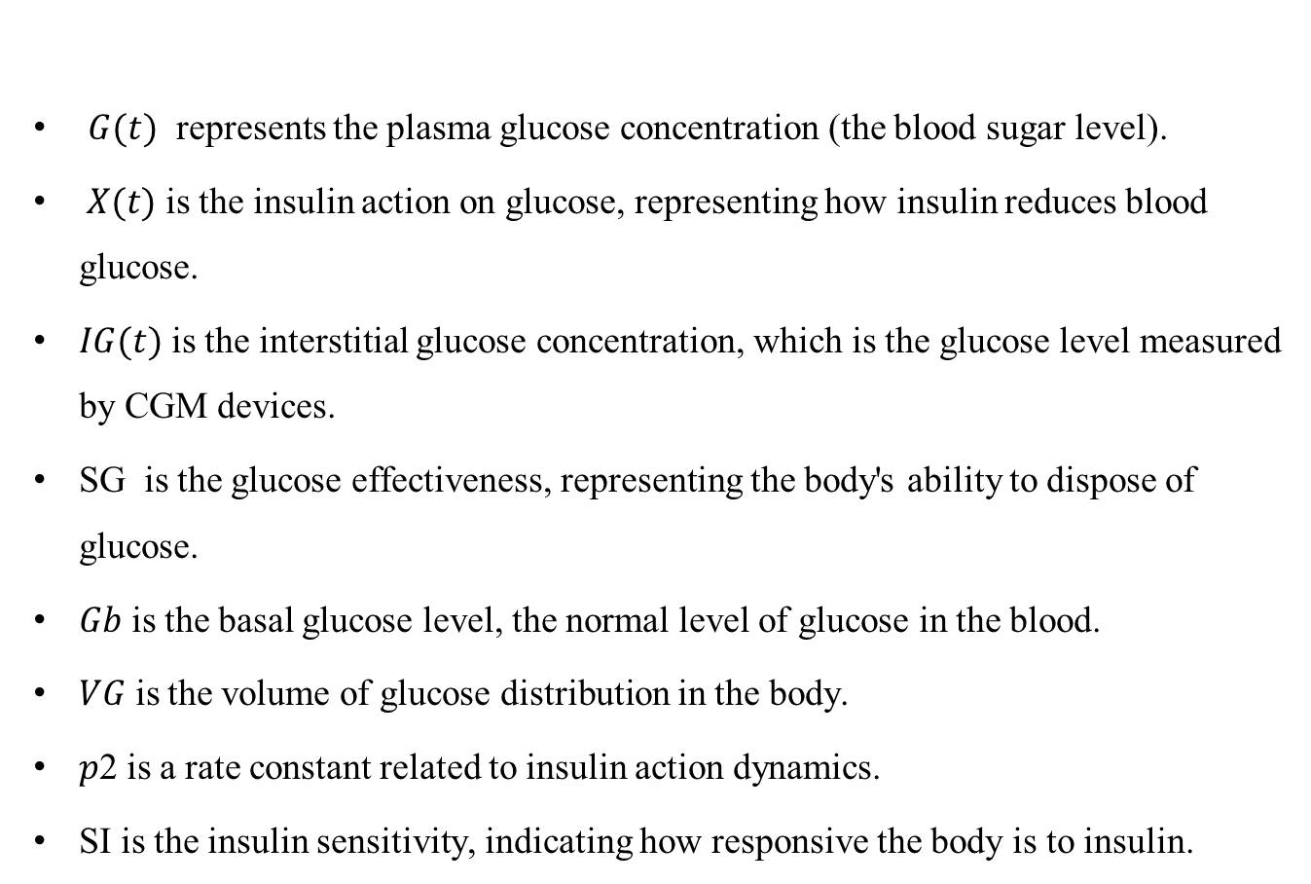
Mepco Schlenk Engineering College (Autonomous)
Problem Definition and Description of Model
$G(t)$ represents the plasma glucose concentration (the blood sugar level).
$X(t)$is the insulin action on glucose, representing how insulin reduces blood glucose.
$IG(t)$is the interstitial glucose concentration, which is the glucose level measured by CGM devices.
SG​ is the glucose effectiveness, representing the body's ability to dispose of glucose.
𝐺𝑏​ is the basal glucose level, the normal level of glucose in the blood.
𝑉𝐺​ is the volume of glucose distribution in the body.
𝑝2 is a rate constant related to insulin action dynamics.
SI is the insulin sensitivity, indicating how responsive the body is to insulin.
Department of Computer Science and Engineering
46

Slide 47
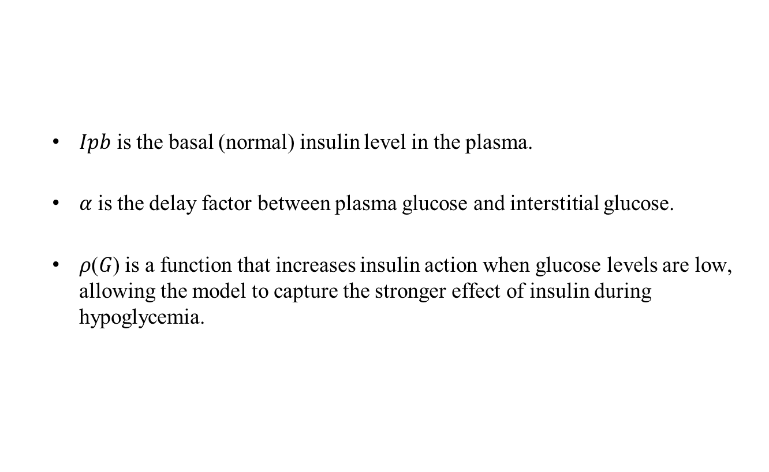
Mepco Schlenk Engineering College (Autonomous)
Problem Definition and Description of Model
$Ipb$is the basal (normal) insulin level in the plasma.
𝛼 is the delay factor between plasma glucose and interstitial glucose.
𝜌(𝐺) is a function that increases insulin action when glucose levels are low, allowing the model to capture the stronger effect of insulin during hypoglycemia.
Department of Computer Science and Engineering
47

Slide 48
Mepco Schlenk Engineering College (Autonomous)
Problem Definition and Description of Model
Black-Box Model Module
Description: This module encompasses several advanced machine learning algorithms designed to capture complex patterns in the data. The specific models implemented include:
Algorithm:
Long Short-Term Memory (LSTM):A type of recurrent neural network (RNN) designed to learn and remember over long sequences.
Gated Recurrent Units (GRU): Another RNN variant that simplifies the architecture while maintaining performance in sequential data tasks .
Temporal Convolutional Network (TCN): Networks designed to handle sequential data, utilizing convolutional layers.
Non Parametric Models: These models use Gaussian Regression to estimate BG Levels based on Input features.
Department of Computer Science and Engineering
48

Slide 49
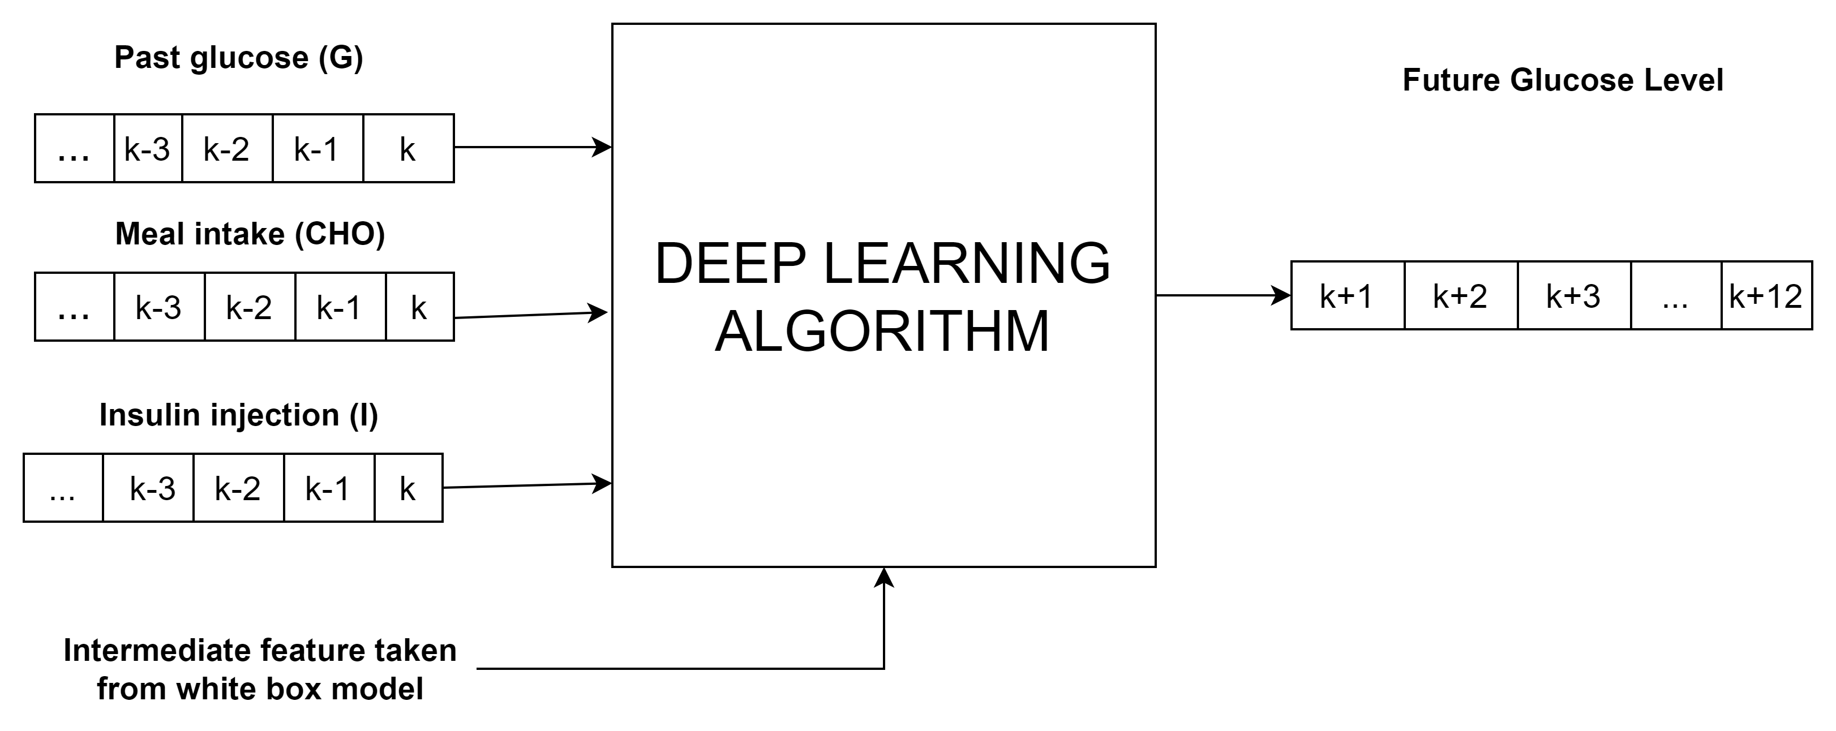
Mepco Schlenk Engineering College (Autonomous)
Problem Definition and Description of Model
SCHEMATIC REPRESENTATION OF BG FORECASTING WITH
LSTM,GRU AND TCN
LSTM
GRU
TCN
NP Model
Department of Computer Science and Engineering
49

Slide 50
Mepco Schlenk Engineering College (Autonomous)
Problem Definition and Description of Model
Techniques:
Models trained on historical data with hyperparameter tuning predict future blood glucose levels, capturing varying postprandial responses.
Model Training: Use Keras in Python to implement and train LSTM, GRU,
and TCN models with GPU acceleration for faster training..
Hyperparameter Tuning: Use Grid Search or Random Search to optimize model parameters like learning rate, batch size, and layers.
Department of Computer Science and Engineering
50

Slide 51
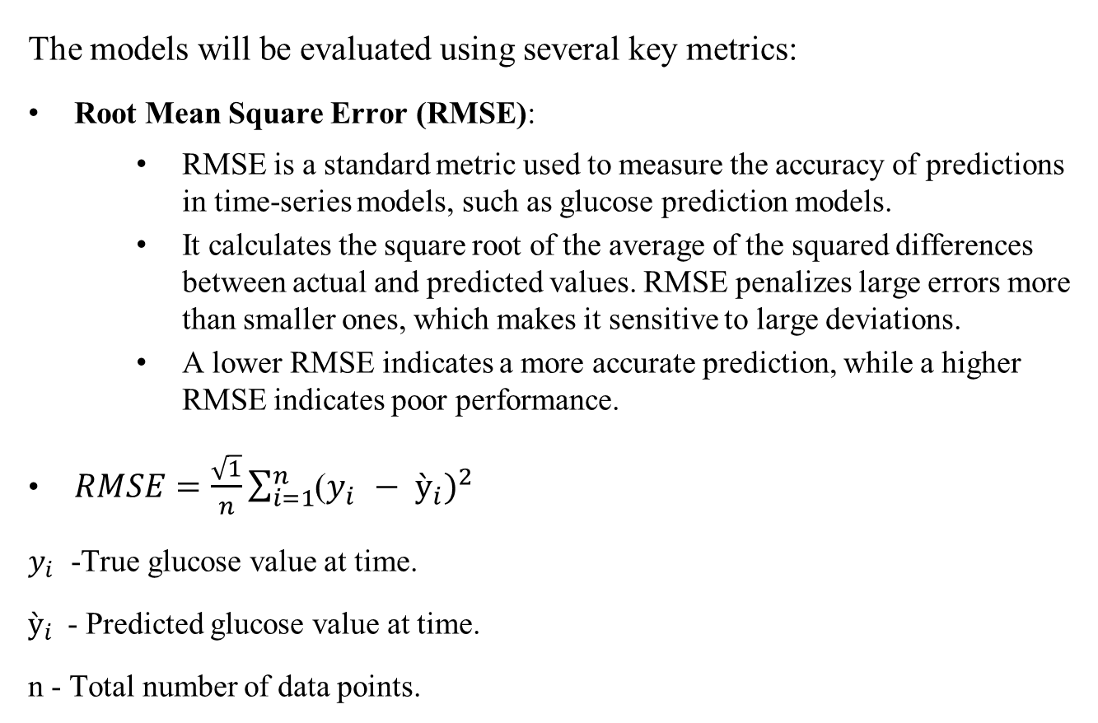
Mepco Schlenk Engineering College (Autonomous)
Evaluation Metrics
The models will be evaluated using several key metrics:
Root Mean Square Error (RMSE):
RMSE is a standard metric used to measure the accuracy of predictions in time-series models, such as glucose prediction models.
It calculates the square root of the average of the squared differences between actual and predicted values. RMSE penalizes large errors more than smaller ones, which makes it sensitive to large deviations.
A lower RMSE indicates a more accurate prediction, while a higher RMSE indicates poor performance.
$RMSE=\frac{\sqrt{1}}{n}\sum_{i=1}^{n}{{\text{(}y_{i }− ỳ_{i})}^{2}}$
$y_{i }$-True glucose value at time.
$ỳ_{i}$ - Predicted glucose value at time.
n - Total number of data points.
Department of Computer Science and Engineering
51

Slide 52
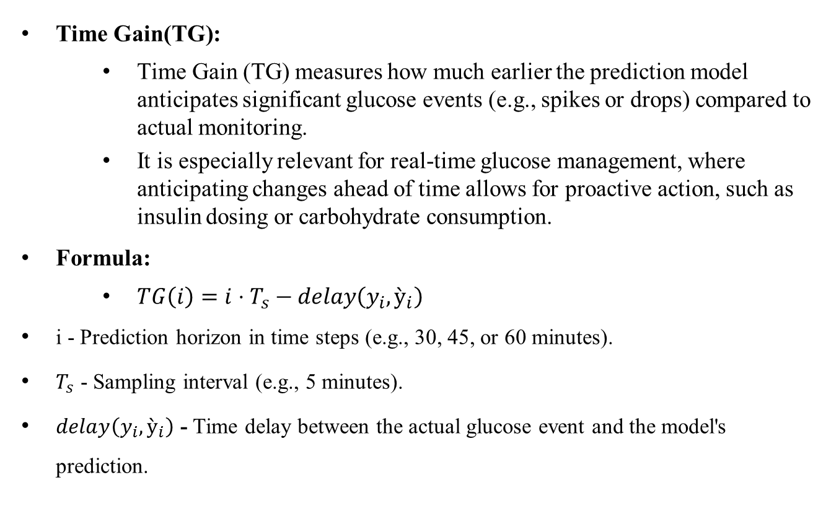
Mepco Schlenk Engineering College (Autonomous)
Evaluation Metrics
Time Gain(TG):
Time Gain (TG) measures how much earlier the prediction model anticipates significant glucose events (e.g., spikes or drops) compared to actual monitoring.
It is especially relevant for real-time glucose management, where anticipating changes ahead of time allows for proactive action, such as insulin dosing or carbohydrate consumption.
Formula:
$TG\left(i\right)=i⋅T_{s}​−delay\left(y_{i}​,ỳ_{i}​\right)$
i - Prediction horizon in time steps (e.g., 30, 45, or 60 minutes).
$T_{s}$ - Sampling interval (e.g., 5 minutes).
$delay\left(y_{i}​,ỳ_{i}​\right)$ - Time delay between the actual glucose event and the model's prediction.
Department of Computer Science and Engineering
52

Slide 53
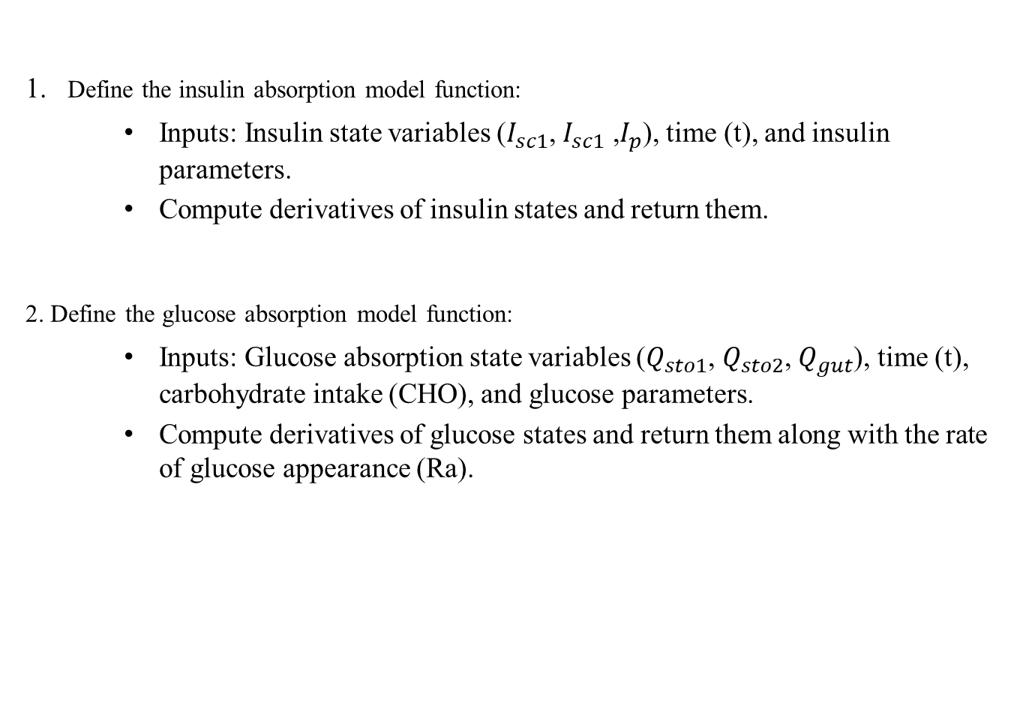
Mepco Schlenk Engineering College (Autonomous)
Pseudo Code
Define the insulin absorption model function:
Inputs: Insulin state variables ($I_{sc1}$, $I_{sc1} \text{,}I_{p}$), time (t), and insulin parameters.
Compute derivatives of insulin states and return them.
2. Define the glucose absorption model function:
Inputs: Glucose absorption state variables ($Q_{sto1}$, $Q_{sto2}$, $Q_{gut}$), time (t), carbohydrate intake (CHO), and glucose parameters.
Compute derivatives of glucose states and return them along with the rate of glucose appearance (Ra).
Department of Computer Science and Engineering
53

Slide 54
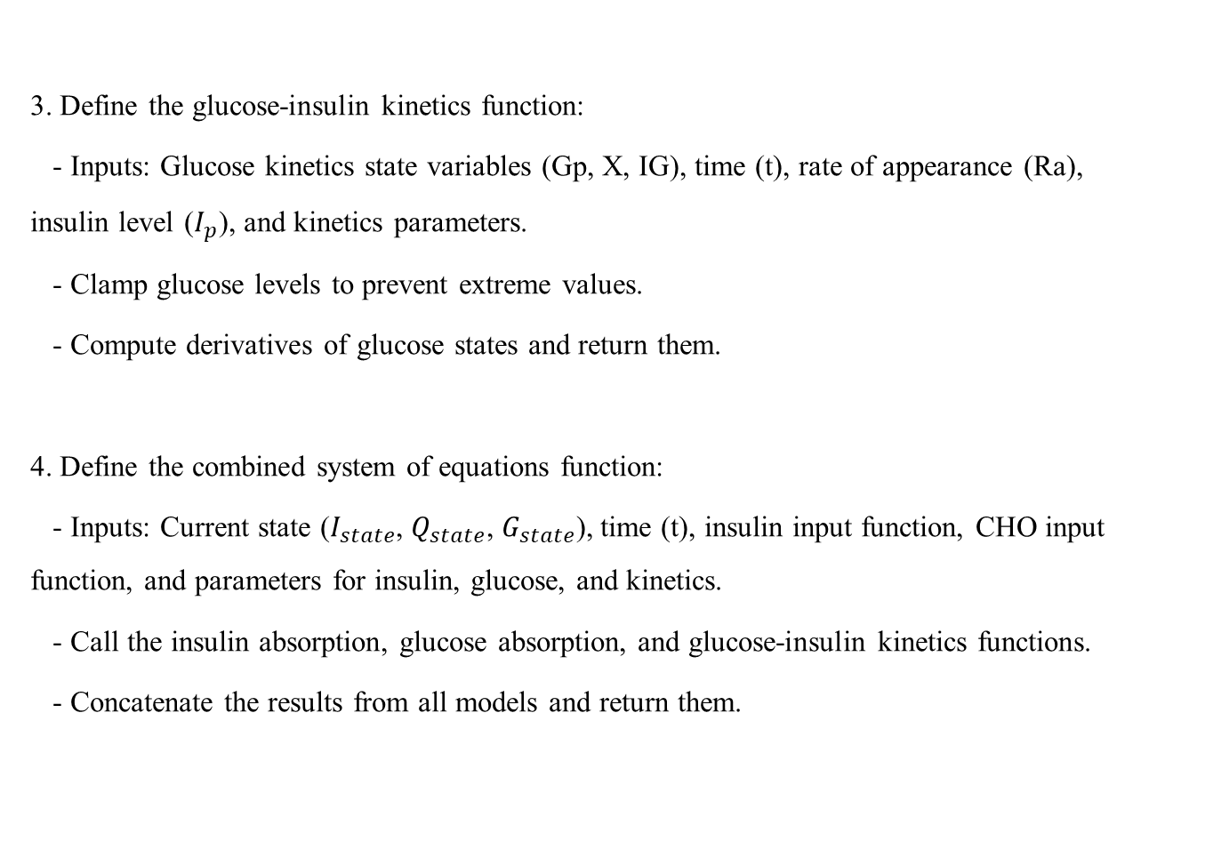
Mepco Schlenk Engineering College (Autonomous)
Pseudo Code
3. Define the glucose-insulin kinetics function:
- Inputs: Glucose kinetics state variables (Gp, X, IG), time (t), rate of appearance (Ra), insulin level ($I_{p}$), and kinetics parameters.
- Clamp glucose levels to prevent extreme values.
- Compute derivatives of glucose states and return them.
4. Define the combined system of equations function:
- Inputs: Current state ($I_{state}$, $Q_{state}$, $G_{state}$), time (t), insulin input function, CHO input function, and parameters for insulin, glucose, and kinetics.
- Call the insulin absorption, glucose absorption, and glucose-insulin kinetics functions.
- Concatenate the results from all models and return them.
Department of Computer Science and Engineering
54

Slide 55
Mepco Schlenk Engineering College (Autonomous)
Pseudo Code
5. Define the insulin input function:
- Calculate the total insulin input based on basal, temp_basal, and bolus data.
6. Define the carbohydrate intake function:
- Calculate the total carbohydrate intake from meal data.
7. Define input functions for insulin and carbohydrate intake:
- Use Input data to define functions for insulin input and CHO input over time.
8. Define parameter values for insulin, glucose absorption, and kinetics models.
9. Access the results from the ODE solver:
- Get the time vector and glucose levels from the solution.
Department of Computer Science and Engineering
55

Slide 56
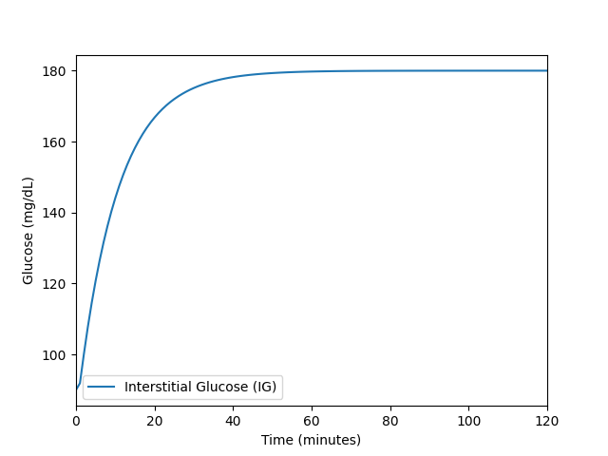
Mepco Schlenk Engineering College (Autonomous)
Partial Implementation
Department of Computer Science and Engineering
56

Slide 57
Mepco Schlenk Engineering College (Autonomous)
Dataset Details
Name:Ohio Type 1 Diabetes Mellitus(https://www.kaggle.com/datasets/ryanmouton/ohiot1dm) (http://smarthealth.cs.ohio.edu/OhioT1DMdataset.html)
Reference:OhioT1DM Dataset, “The OhioT1DM Dataset for Blood Glucose Level Prediction: Update 2020”
Dataset Description:
The dataset contains patient information for Type 1 Diabetes Mellitus, specifically focusing on glucose levels and insulin types. The data is stored in an XML format, providing structured and timestamped glucose readings.
Key Components of the Dataset:
1)Patient Details:
ID(Integer): Unique identifier for each patient (e.g., 559).
Weight(Float/Integer): The weight of the patient in kilograms (e.g., 99).
Insulin Type(String): Type of insulin used by the patient (e.g., Novalog).
2)Glucose Level Readings:
Timestamp (ts)(DateTime): Date and time when the glucose level was recorded (e.g., 18-01-2022 00:01:00).
Value(Double): The recorded glucose level at that specific timestamp (e.g., 179).
Department of Computer Science and Engineering
57

Slide 58
Mepco Schlenk Engineering College (Autonomous)
Dataset Details
3.Finger Stick:Blood glucose values obtained through self-monitoring by the patient.
4. Basal:The basal insulin rate is continuously infused from the specified timestamp 𝑡𝑠​ until a new rate is set.
5. Temp Basal:A temporary basal insulin rate replaces the normal basal rate. A value of 0 indicates suspended insulin flow. At the end of the temp basal, the rate returns to normal.
6. Bolus:Insulin delivered to the patient, typically before meals or during hyperglycemia. The normal bolus delivers all insulin at once, while other types can spread the dose over the period between 𝑡𝑠 begin and 𝑡s​ end.
7. Meal:The self-reported time and type of a meal, plus the patient’s carbohydrate estimate for the meal.
8. Sleep:The times of self-reported sleep, plus the patient’s subjective assessment of sleep quality: 1 for Poor; 2 for Fair; 3 for Good.
Followed by Work, stressors, illness, exercise, basis heart rate ,basis gsr ,basis skin and air temperature, basis steps, basis sleep and acceleration.
Department of Computer Science and Engineering
58

Slide 59
Mepco Schlenk Engineering College (Autonomous)
Working Environment
1.Software Tools:
Data Management and Analysis and Visualization:
Python Programming
Libraries:(NumPy,MatPlotlib,Pandas,Tensorflow)
Integrated Development Environment (IDE):
Jupyter Notebook or Google Colab or Visual Studio Code.
2.Hardware Requirements:
Processor:Intel i5 or Similar
RAM:8GB or more
GPU: NVIDIA GTX 1050 / Intel® Iris® Xe Graphics
Storage: SSD with at least 256 GB of space
3.Environmental Setup:
Operating System:Windows 10/11, macOS, or Linux (e.g., Ubuntu).
Version Control:
GitHub: For managing changes to your code.
Department of Computer Science and Engineering
59

Slide 60
Mepco Schlenk Engineering College (Autonomous)
REFERENCES
Base Paper:
1.Giacomo Cappon , Francesco Prendin , Andrea Facchinetti , Giovanni Sparacino and Simone Del Favero, “Individualized Models for Glucose Prediction in Type 1 Diabetes: Comparing Black-Box Approaches to a Physiological White-Box One”, IEEE TRANSACTIONS ON BIOMEDICAL ENGINEERING, VOL. 70, NO. 11, NOVEMBER 2023.
References:
1. Cindy Marling1, Razvan Bunescu1, “The OhioT1DM Dataset for Blood Glucose Level Prediction Update 2020”, EUR Workshop Proc. 2020 September ; 2675: 71–74
Department of Computer Science and Engineering
60

Slide 61
Mepco Schlenk Engineering College (Autonomous)
REFERENCES
2. Mario Munoz-Organero, “Deep physiological model for blood glucose prediction in T1DM patients”, Sensors 2020, 20,3896.
3. Ganjar Alfian , Muhammad Syafrudin , Muhammad Anshari, “Blood glucose prediction model for type 1 diabetes based on artificial neural network with time-domain features”, biocybernetics and biomedical engineering 40(2020) 1586 – 1599
4. Jobeda Jamal Khanam, Simon Y. Foo, “A comparison of machine learning algorithms for diabetes prediction”, ICT Express 7 (2021) 432-439.
Department of Computer Science and Engineering
61

Slide 62
Mepco Schlenk Engineering College (Autonomous)
REFERENCES
5. Jobeda Jamal Khanam, Simon Y. Foo, “A comparison of machine learning algorithms for diabetes prediction”, ICT Express 7 (2021) 432-439.
6. Wonju Seoa, Sung-Woon Park , Namho Kima, Sang-Man Jinc, Sung-Min Parka, “A personalized blood glucose level prediction model with a fine-tuning strategy: A proof-of-concept study”, Computer Methods and Programs in Biomedicine 211 (2021) 106424.
7. Hatice Vildan Dudukcu, Murat Taskiran, Tulay Yildirim, “Blood glucose prediction with deep neural networks using weighted decision level fusion”, biocybernetics and biomedical engineering 41 (2021) 1208– 1223.
Department of Computer Science and Engineering
62

Slide 63
Mepco Schlenk Engineering College (Autonomous)
REFERENCES
8. . Hatice Vildan Dudukcu, Murat Taskiran, Tulay Yildirim, “Blood glucose prediction with deep neural networks using weighted decision level fusion”, biocybernetics and biomedical engineering 41 (2021) 1208– 1223.
9. Gangani Dharmarathne, Thilini N. Jayasinghe, Madhusha Bogahawaththa, D.P.P. Meddage, Upaka Rathnayake, “A novel machine learning approach for diagnosing diabetes with a self-explainable interface”, Healthcare Analysis, (2024) 100301.
10. Sean Pikulin, Irad Yehezkel, Robert Moskovitch,“Enhanced blood glucose levels prediction with a smartwatch”, PLoS ONE 19(7) (2024).
Department of Computer Science and Engineering
63

Slide 64
Mepco Schlenk Engineering College (Autonomous)
THANK YOU
Department of Computer Science and Engineering
64

